Slide 1

Stage 6
Take Your Time Or The Shot
Course Designer: Marcel Englmaier
Take Your Time Or The Shot is a 21 round, 105 point Comstock long course. There are 10 USPSA targets and 1 steel targets. The best two hits per target will score. Steel must fall to score. The start signal is audible
The Handgun start position is anywhere inside the shooting area, handgun loaded and holstered, wrists below belt.
The PCC start position is anywhere inside the shooting area, PCC loaded, stock on belt, muzzle generally downrange.
On the audible start signal, engage all targets from within the shooting area.
Minipopper activates Flipup target and MaxTrap.
Notes:
‹#›

Slide 2
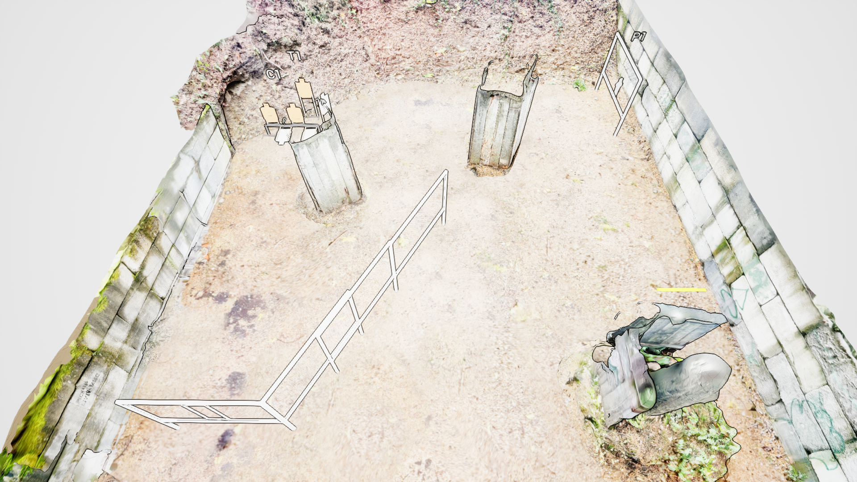
 | Stage 6 Take Your Time Or The Shot Course Designer: Marcel Englmaier

